Slide 1
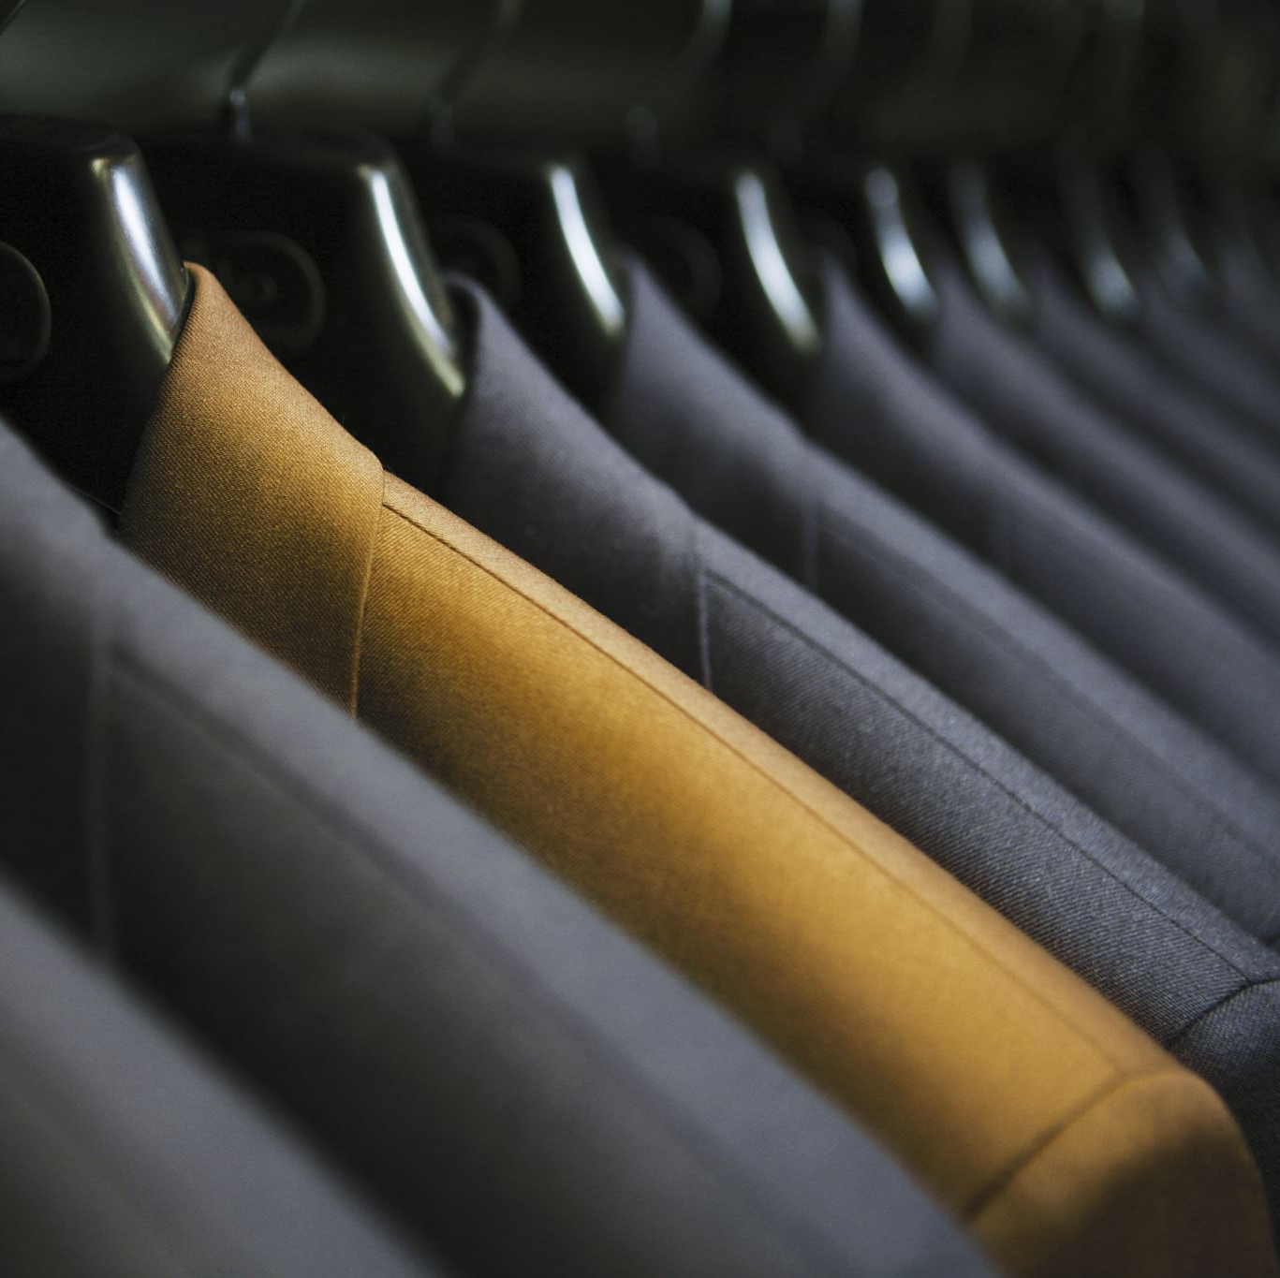
Outfit Suggestion Using Learned Embeddings
Ian Whitehouse

Slide 2
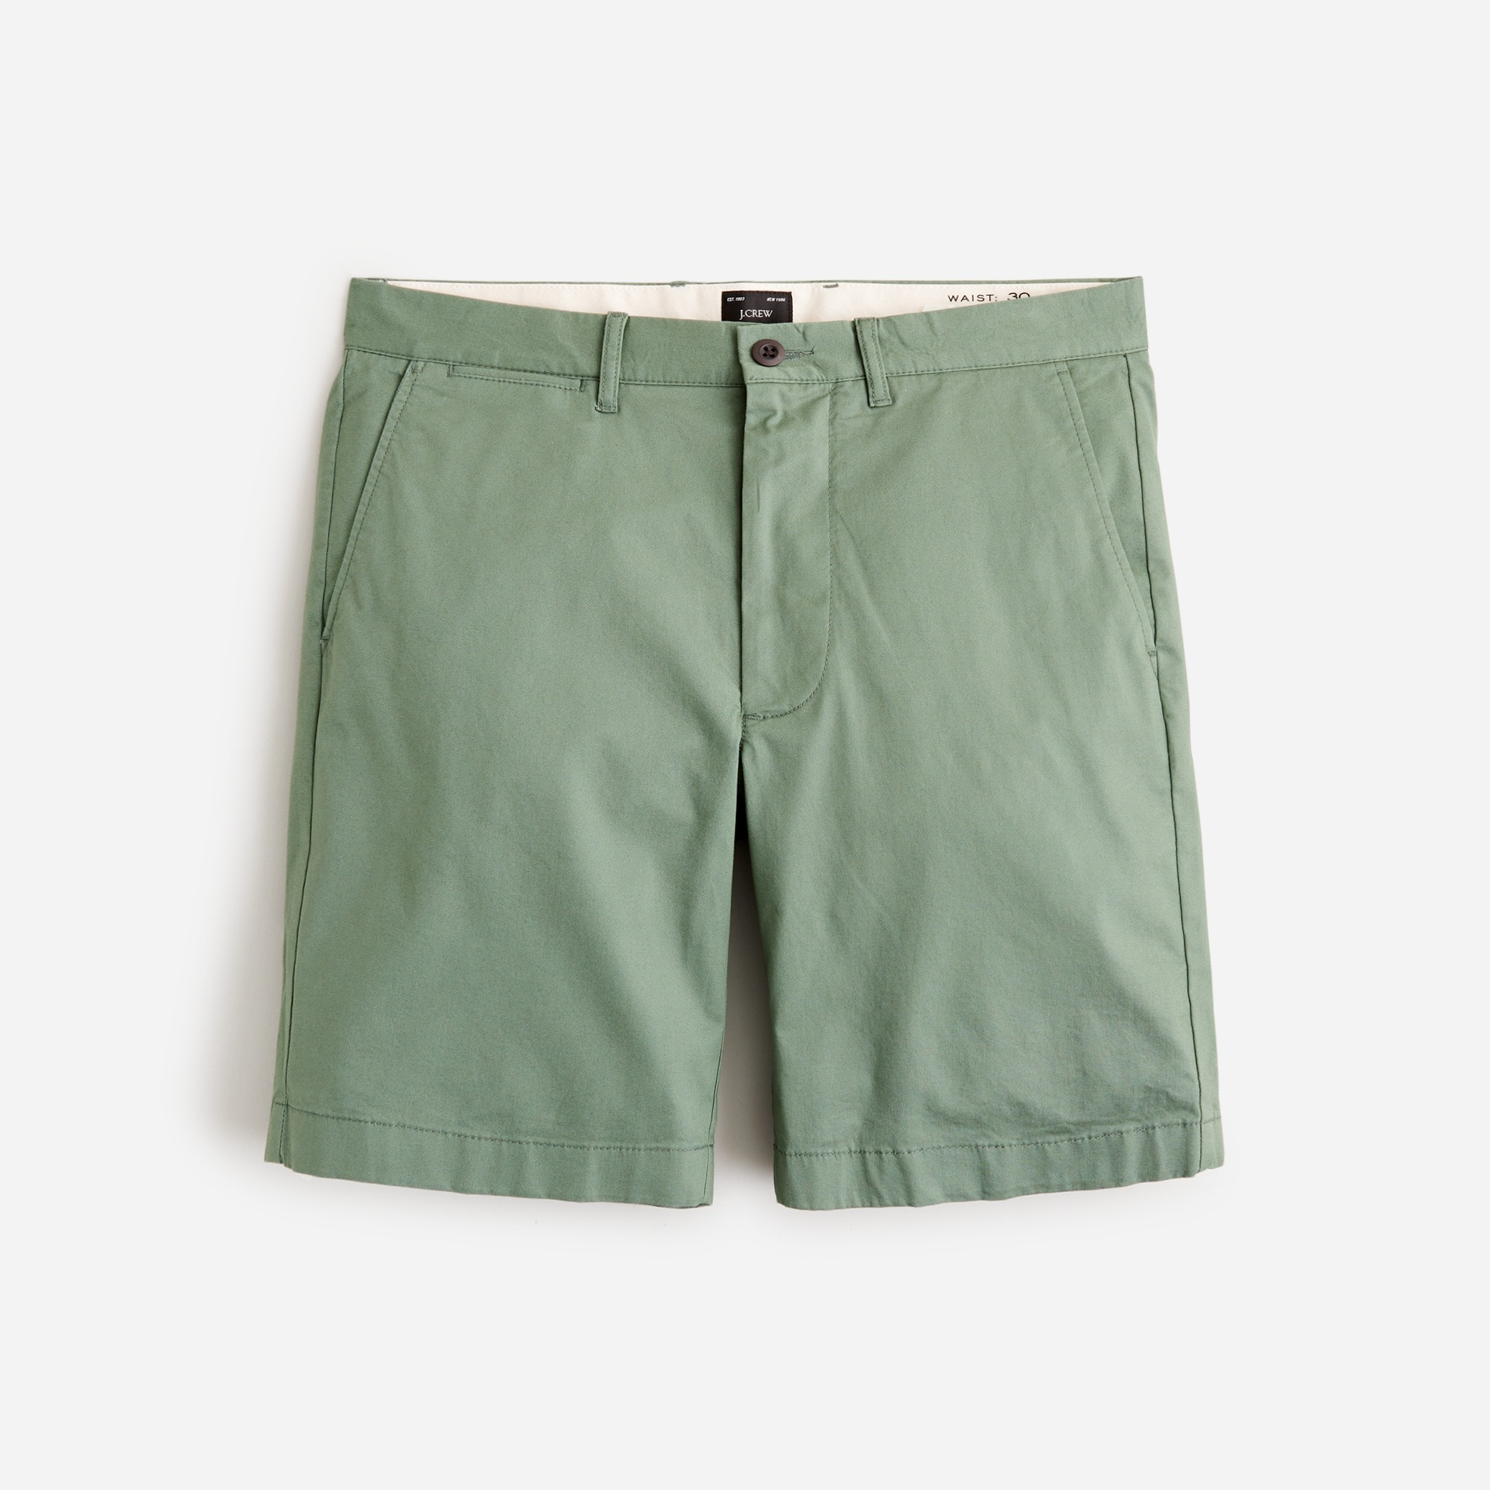
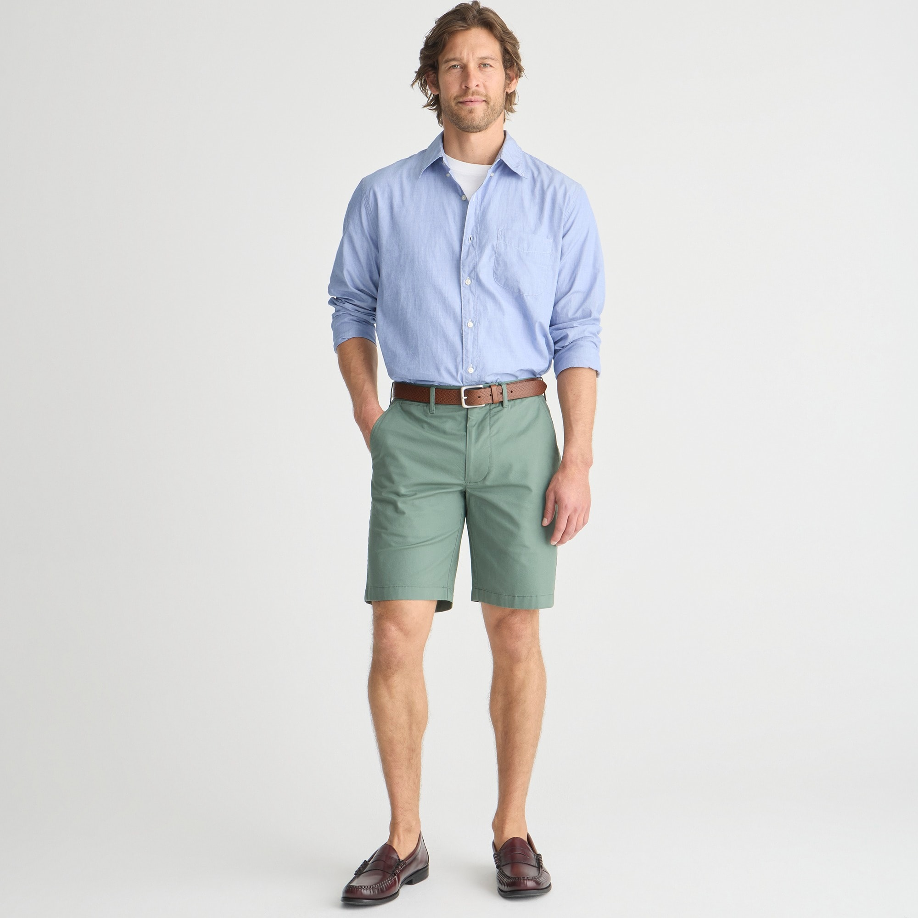
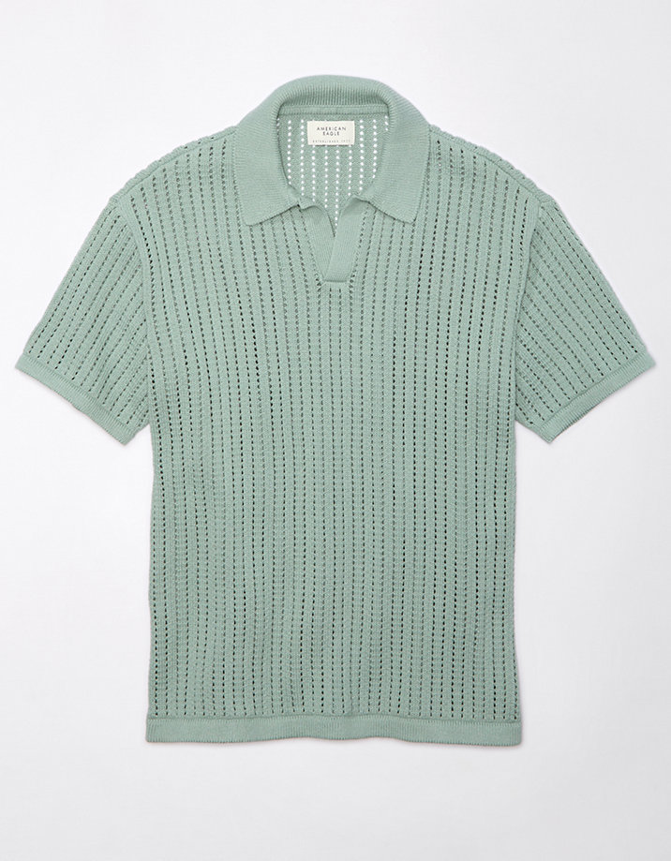
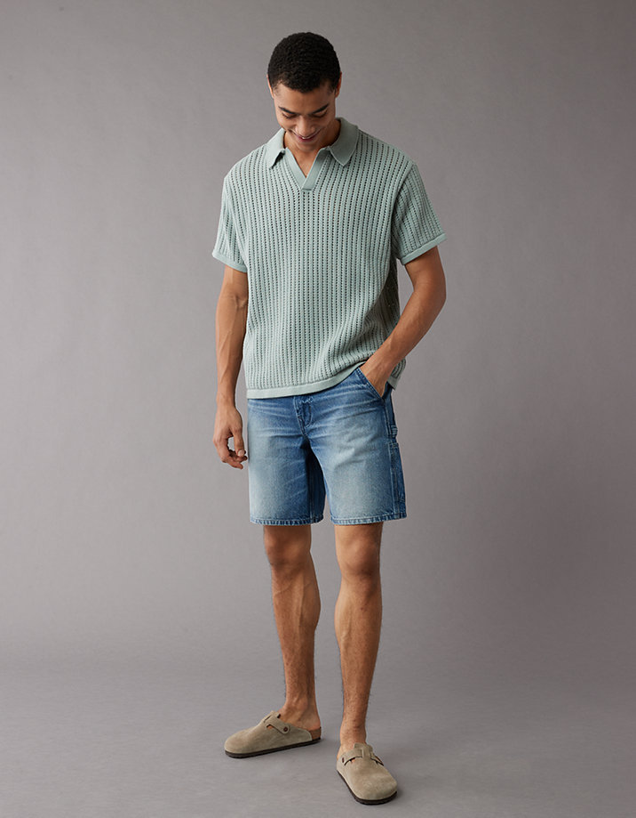
Motivation and Overview
“What goes with this shirt?”
This project attempted to suggest outfits based on single pieces of clothing using embedding models

Slide 3
Clothing & Outfit Dataset
Used 1,200 item-outfit pairs downloaded from J-Crew and American Eagle
Both websites used the Adobe Scene7 CDN, which has an easy-to-use API
API format: https://[Scene 7 Server]/[Item_id]_[Image type]
Images were cropped to center the subject and downsized to 488 by 488
Complications
The image type was inconsistent: each listing used a different image type code to represent full-outfit images
Listing sometimes did not include full-outfit angles, or the images were poor quality

Slide 4
Embedding Models
This project used I-JEPA, InceptionResNetV2, and VGG19
I-JEPA is a SOTA transformer-based model that uses a novel self-supervised algorithm
InceptionResNetV2 combines the Inception model with residual connections. It is one of the most powerful CNN-based models with 164 layers
VGG19 is a CNN-based model with 19 layers
Each model was pretrained on ImageNet
After clothing items were converted to their embeddings, a KNN could match novel items to items included in the dataset

Slide 5
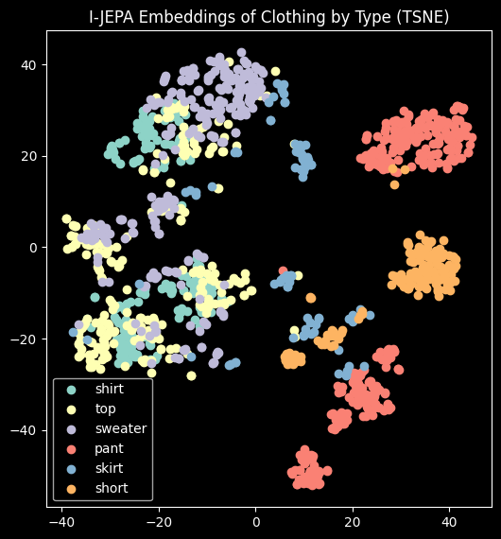
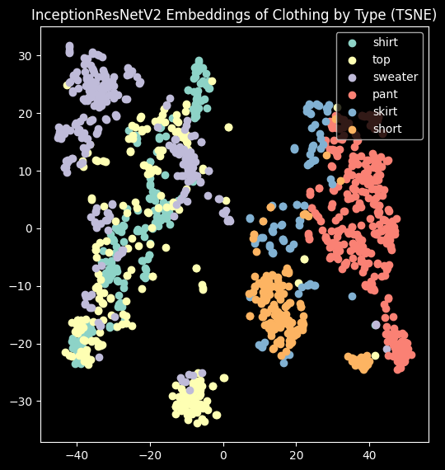
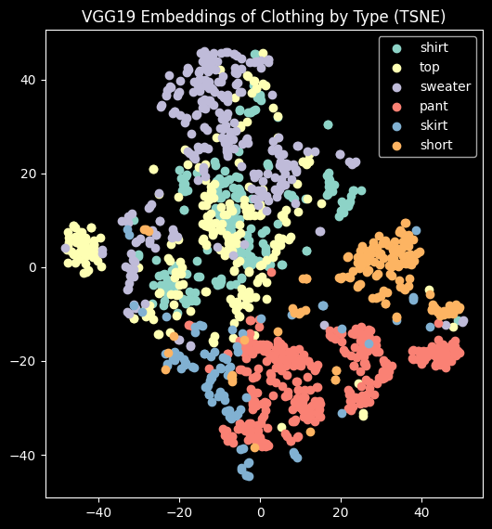
Clothing Item Embeddings

Slide 6
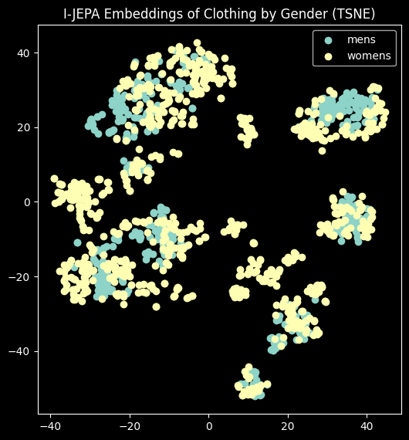
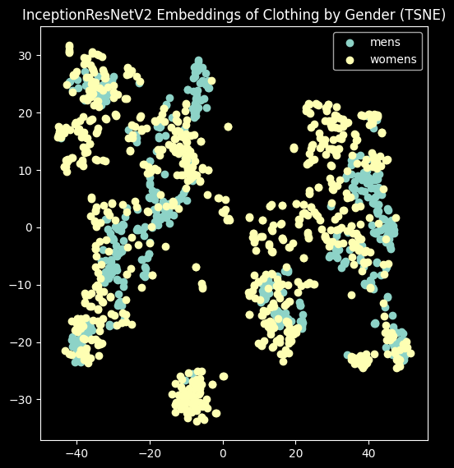
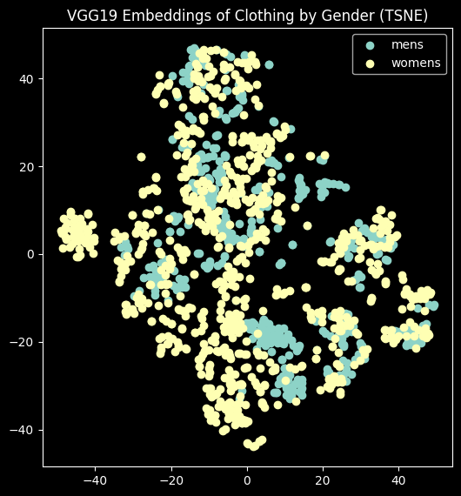
Clothing Item Embeddings

Slide 7
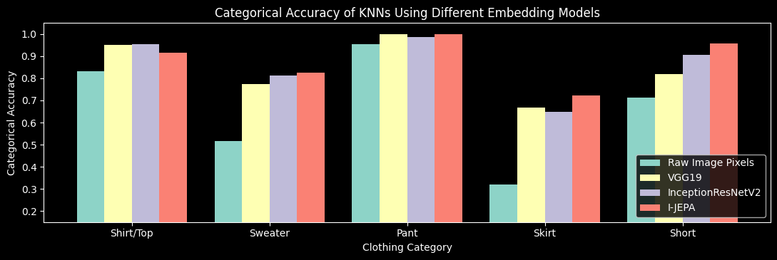
Quantitative Results

Slide 8
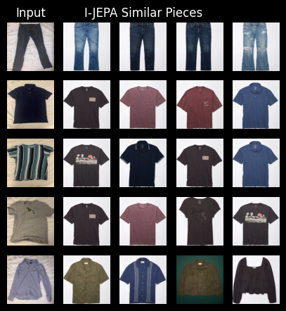
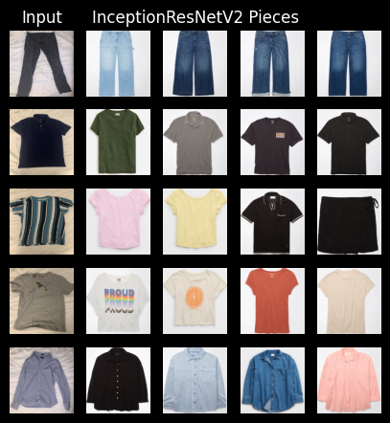
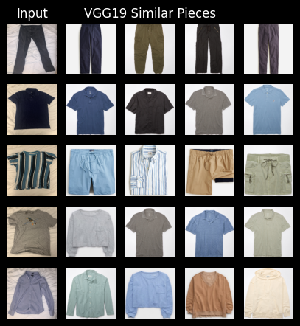
Finding Similar Items to Novel Images

Slide 9
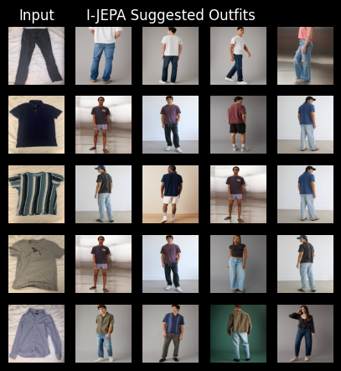
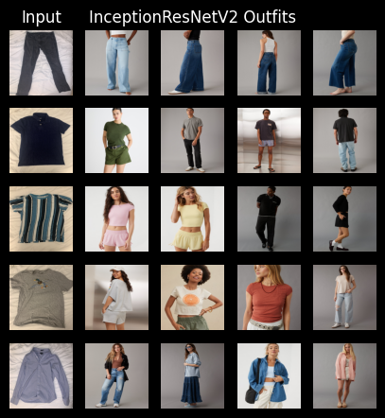
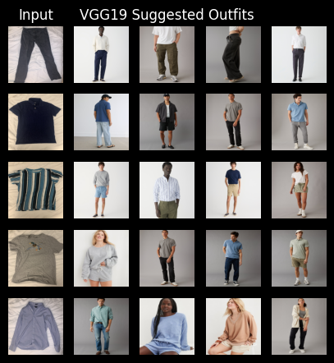
Suggesting Outfits From Novel Images

Slide 10
Conclusions
The embedding models clearly generate different quality outfits
Only I-JEPA consistently returned outfits on male models based on my men’s clothing
The embedding models clustered images dramatically differently
InceptionResNetV2 was the only model to generate a distinct sweater or top clusters
I-JEPA developed multiple pants clusters and multiple shirt/top/sweater clusters
The embedding models performed significantly better than raw image pixels, despite them being trained on vastly different images
The models did not generate good outfits for the test images, suggesting a flawed methodology

Slide 11
Citations
M. Assran, Q. Duval, I. Misra, P. Bojanowski, P. Vincent, M. Rabbat, Y. LeCun and N. Ballas, "Self-Supervised
Learning from Images with a Joint-Embedding Predictive Architecture," arXiv, 2023.
Y. LeCun, Interviewee, Yann LeCun, Chief AI Scientist at Meta AI: From Machine Learning to Autonomous
Intelligence. [Interview]. 25 May 2023.
C. Szegedy, S. Loffe, V. Vanhoucke and A. Alemi, "Inception-v4, Inception-ResNet and the Impact of Residual
Connections on Learning," arXiv, 2016.
F. Chollet, "Keras," 2015.
K. Simonyan and A. Zisserman, "Very Deep Convolutional Networks for Large-Scale Image Recognition," arXiv,
2014.
F. Pedregosa, G. Varoquaux, A. Gramfort, V. Michel, B. Thirion, O. Grisel, M. Blondel, P. Prettenhofer, R. Weiss, V.
Dubourg, J. Vanderplas, A. Passos, D. Cournapeau, M. Brucher, M. Perrot and E. Duchesnay, "Scikit-learn:
Machine Learning in Python," Journal of Machine Learing Research, vol. 12, no. 85, p. 2825−2830, 2011.

